Slide 1
Planting Intentions
October 6, 2020
Julie Wisch
Oliver Causey
Song Yuanhong
Charles Yeh

Slide 2
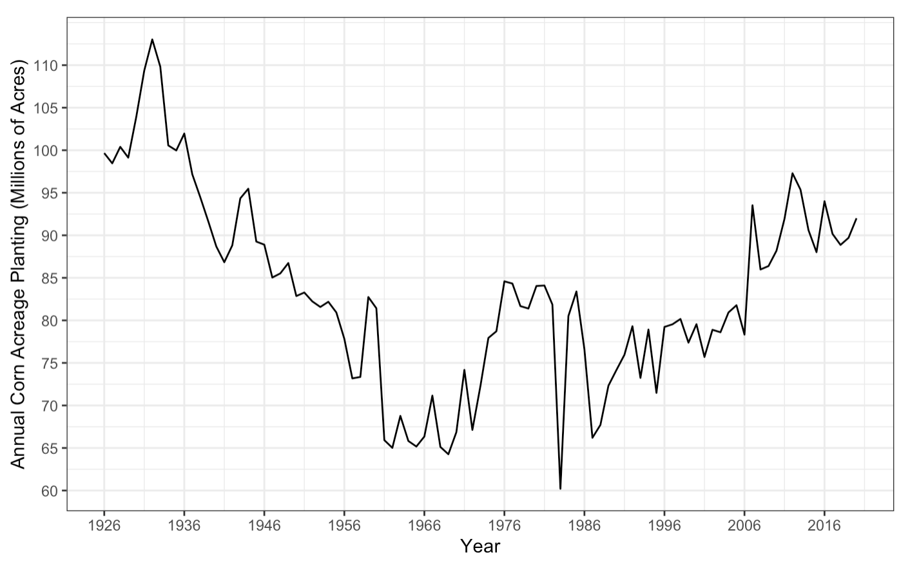
How many acres of corn will be planted next year?

Slide 3
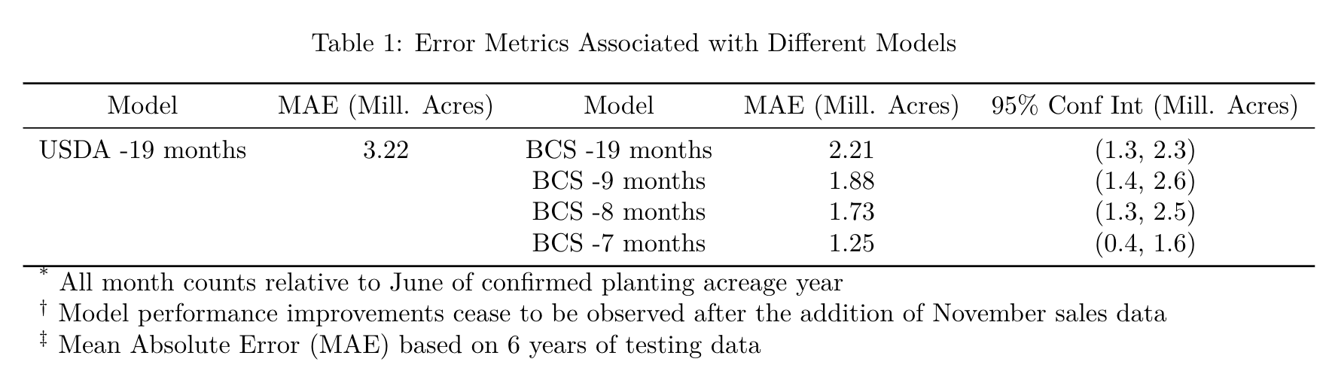
Model Performance

Slide 4
Can we predict corn acreage at the state level?
Key Differences in state level modeling:
Greater variance
USDA projections are only released at the national level

Slide 5
Things We Tried
Data Sources
Historical national planting corn acreage (source: USDA)
Historical state level planting corn acreage (source: USDA)
Historical state level planting soy acreage (source: USDA)
Historical price received per bushel of corn, state level (source: USDA)
Historical state level sales (source: Internal)
In season state level sales as they became available (source: Internal)
USDA Model Projection for National Planting
Modeling Approaches
Assume what happened last year will happen this year (naïve case)
Simple Linear Regression (Planting ~ State)*
Lasso Regression*
Generalized Additive Model*
XGBoost with and without feature selection*
*Used a sliding 8 year training window, consistent with the National Modeling Approach
Years of data used: 1999 - 2018

Slide 6
Things We Tried
Feature Engineering
Generating lagged variables (1 and 2 year lags)
Target encoding “State”
Estimating the Projection for State Planting (State Planting Acreage_lag1 / National Planting Acreage_lag1) * USDA Projection
Breaking the Model as a Sanity Check
Jitter Test
Different Levels of Aggregation
First tried county level (epic failure)
State Level
Pricing Zone Level (14 zones)
National Level
*Used a sliding 8 year training window, consistent with the National Modeling Approach

Slide 7
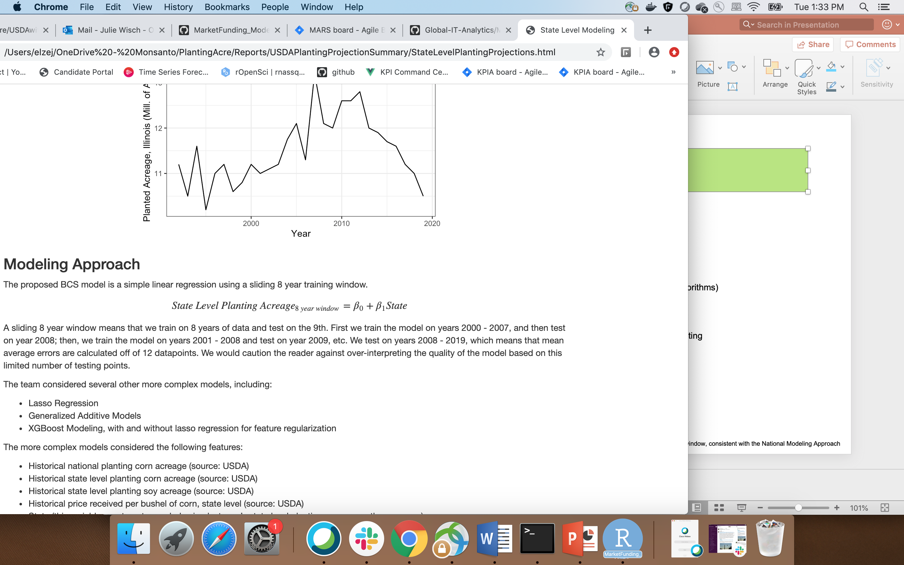
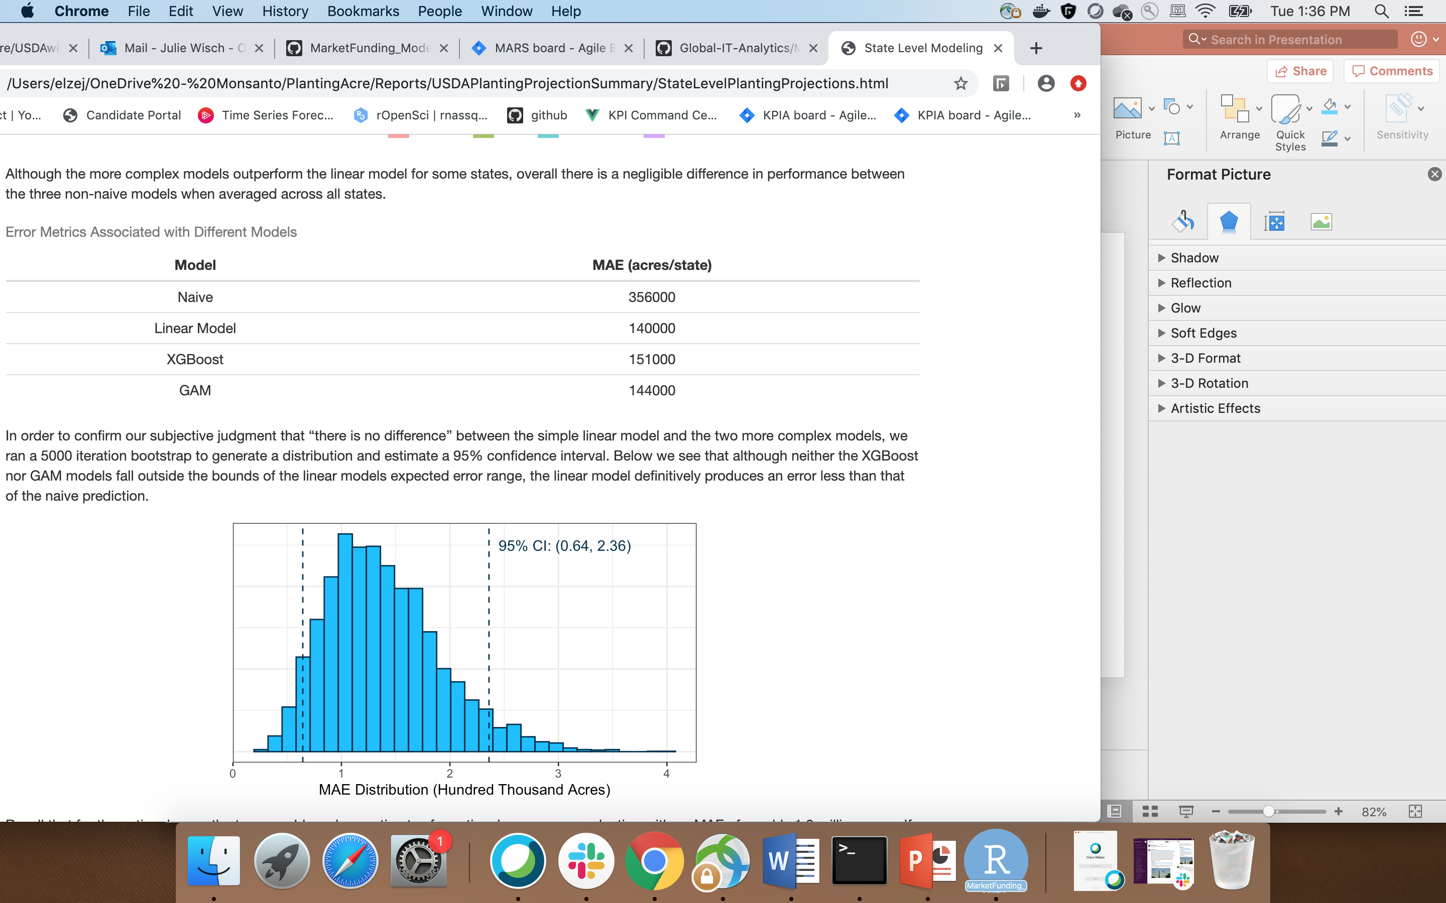
What Worked Best
*Used a sliding 8 year training window, consistent with the National Modeling Approach

Slide 8
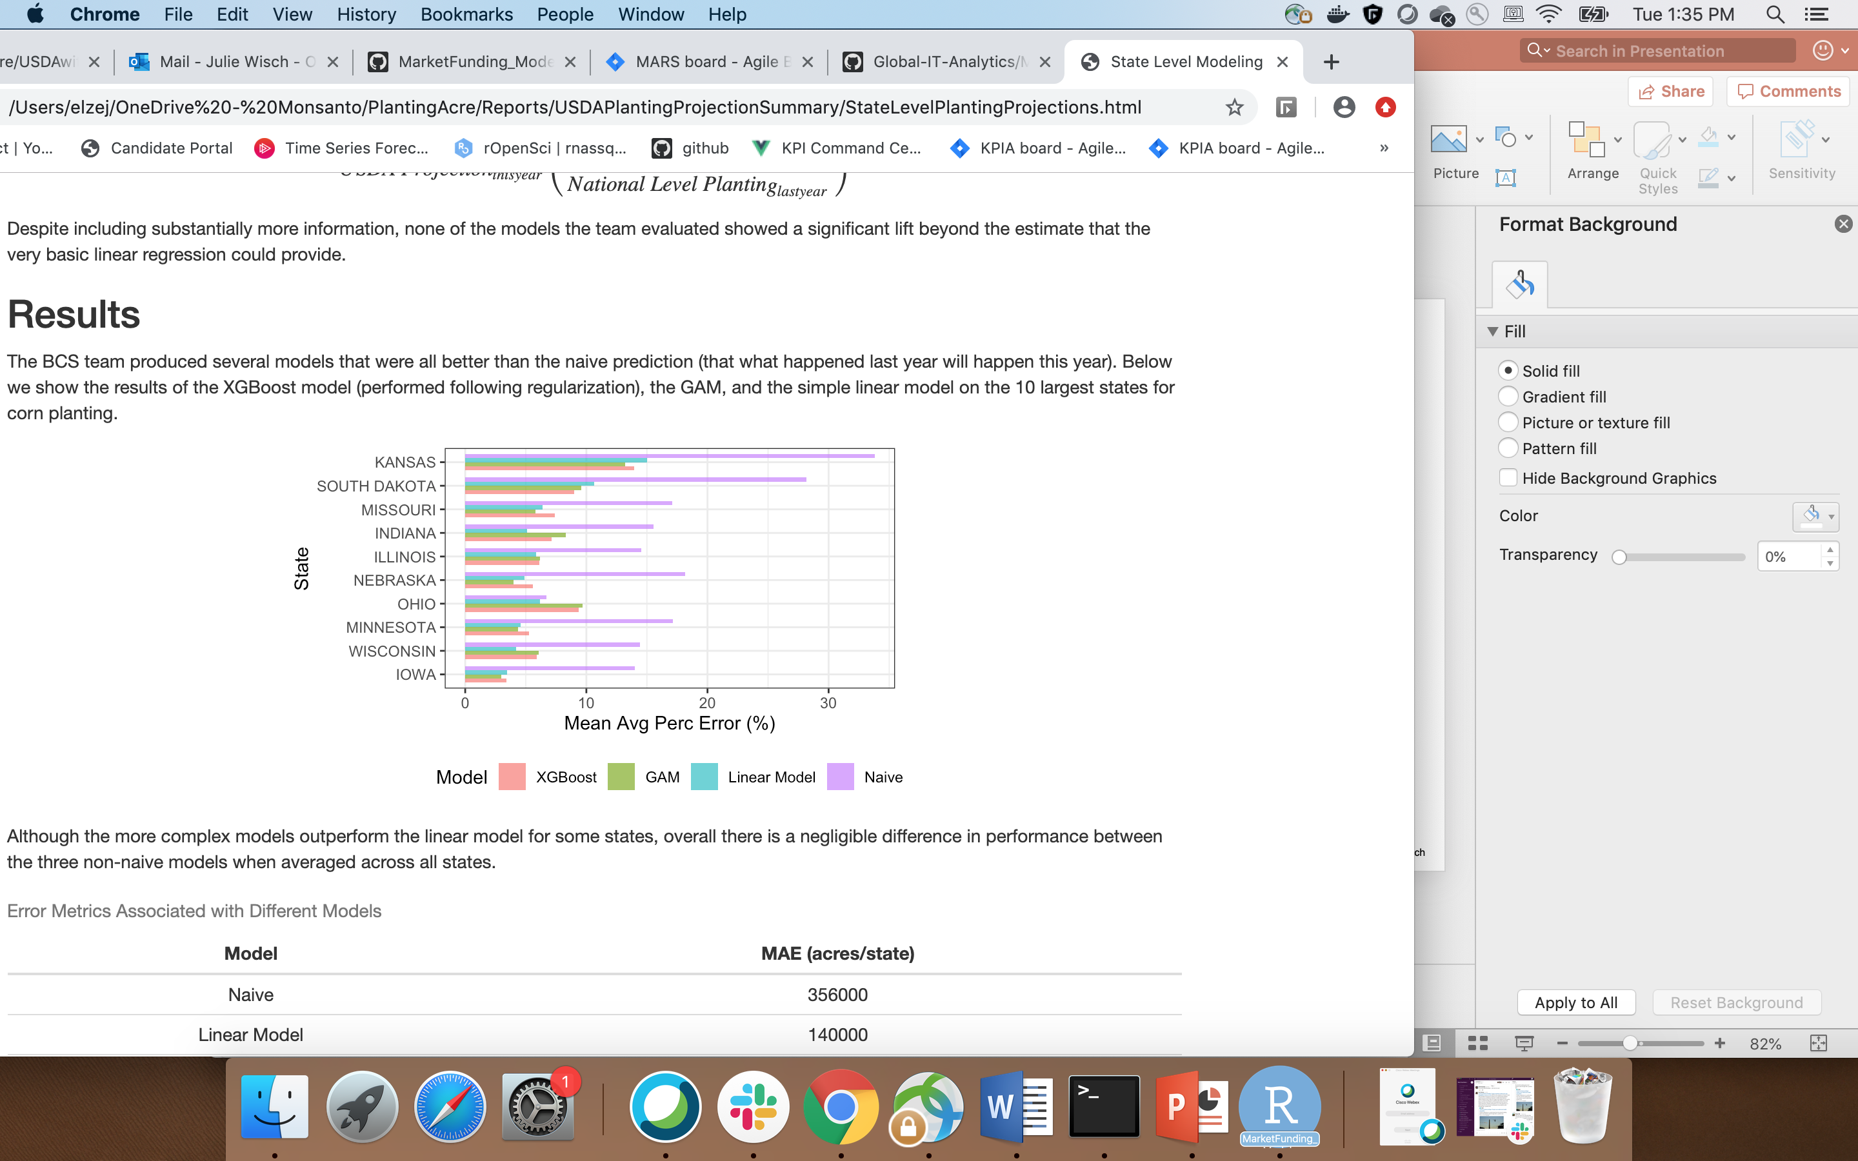
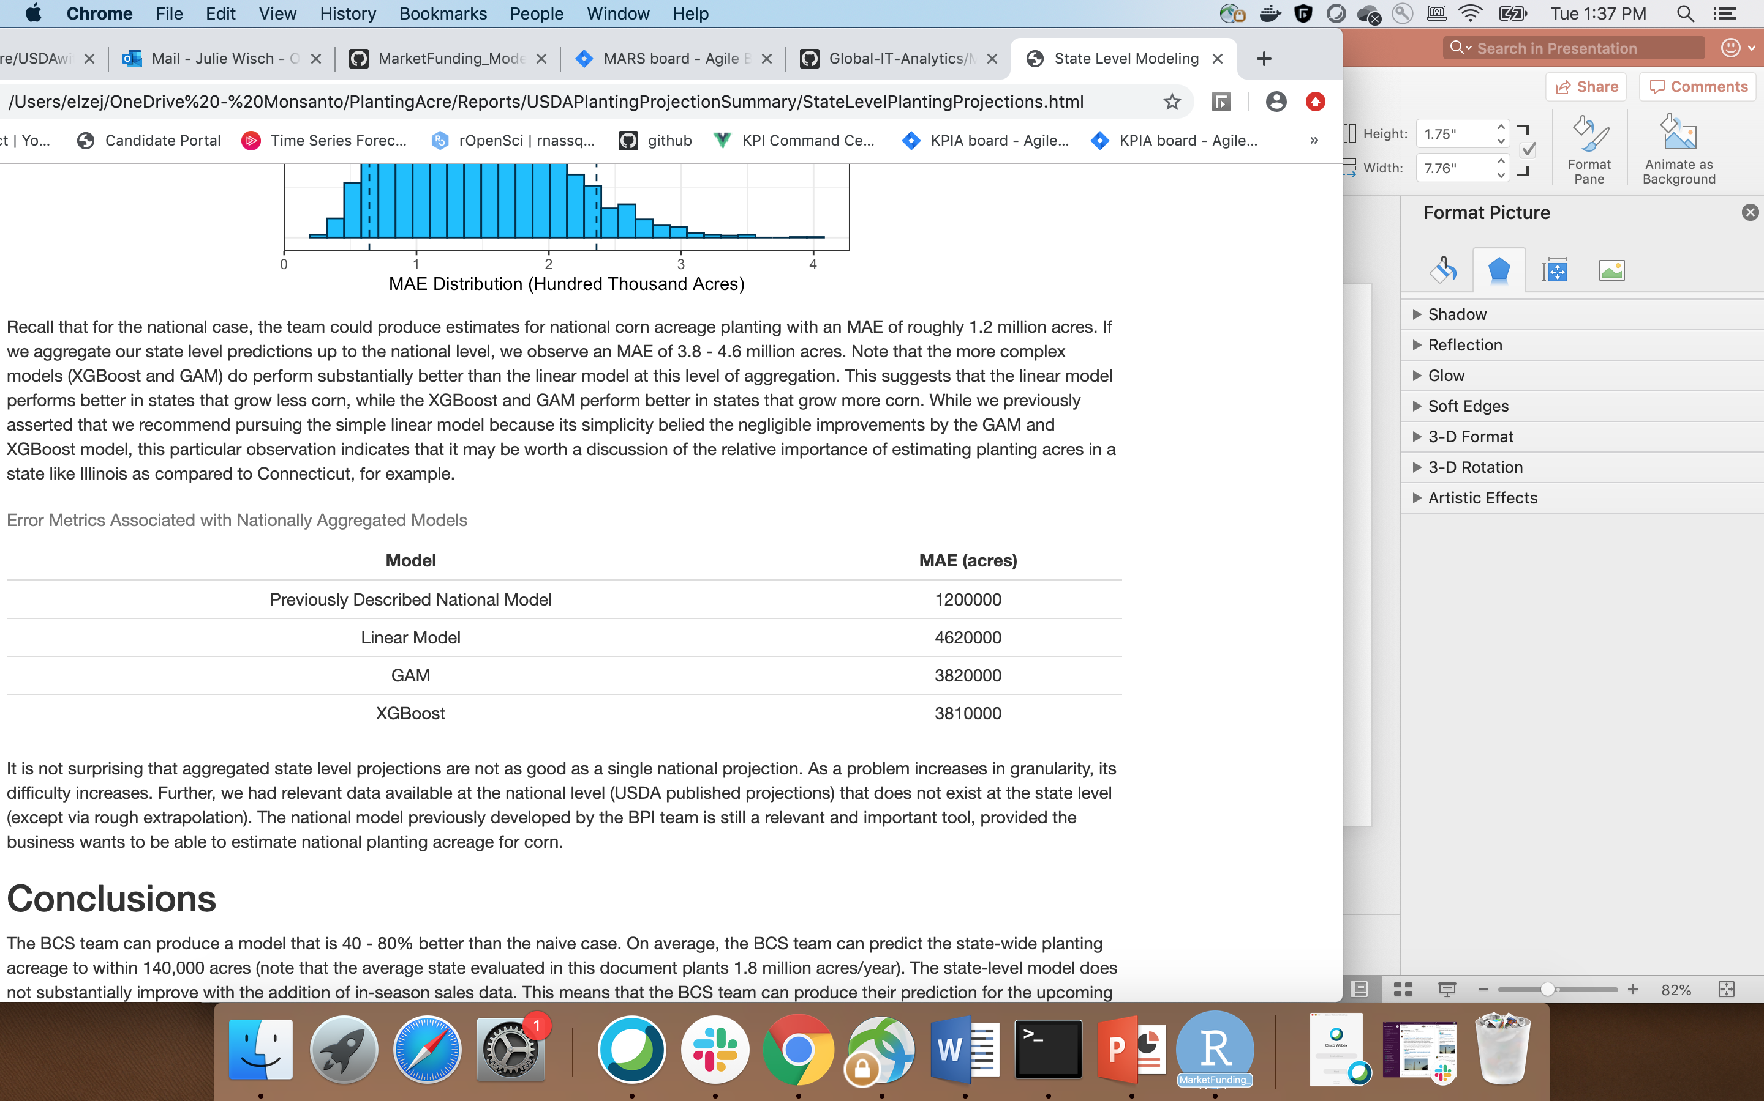
Comparison of Errors

Slide 9
Conclusions
We can produce a model that is 40 – 80% better than the naïve case (MAE = 140,000 acres)
The simple linear model performs better in smaller states, the more complex models (both GAM and XGBoost) perform better in larger states
We can produce our estimate as early as June 2021 for a March 2022 planting
The national level model previously constructed is still better for a national level predictions

